Slide 1
MMAT 5390: Mathematical Imaging
Lecture 11:
Example of Image sharpening, linear/nonlinear image filtering,
Prof. Ronald Lok Ming Lui
Department of Mathematics,
The Chinese University of Hong Kong

Slide 2
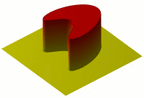
Isotropic diffusion

Slide 3
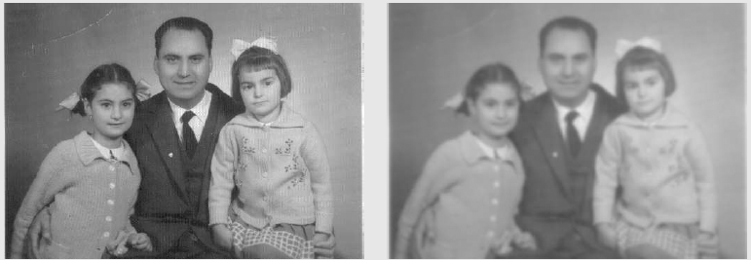
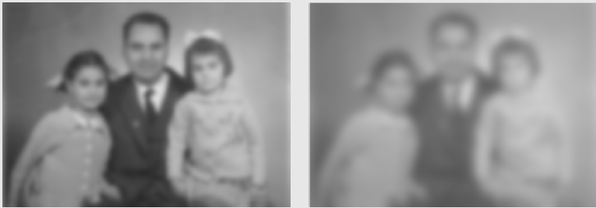
Isotropic diffusion
Original image
Sigma = 1.98
Sigma = 4.28
Sigma = 8.24

Slide 4
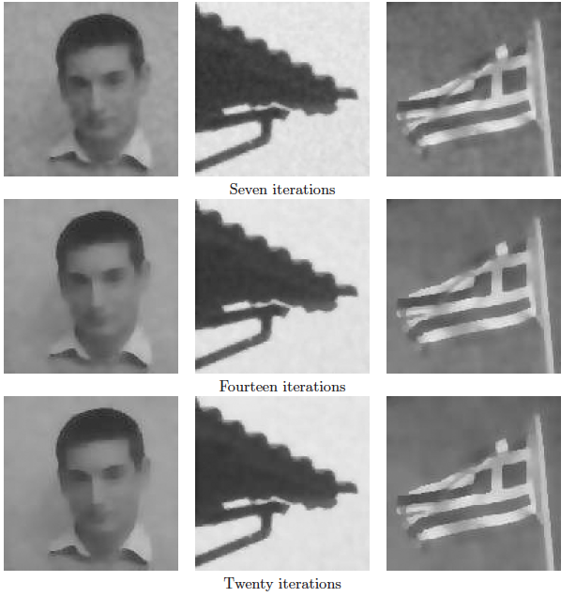
Anisotropic diffusion

Slide 5
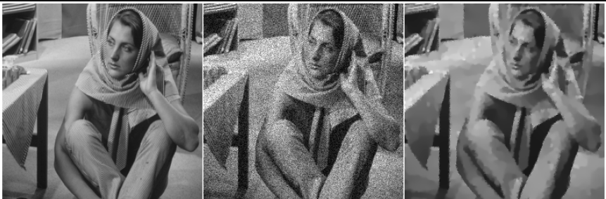
Anisotropic diffusion

Slide 6
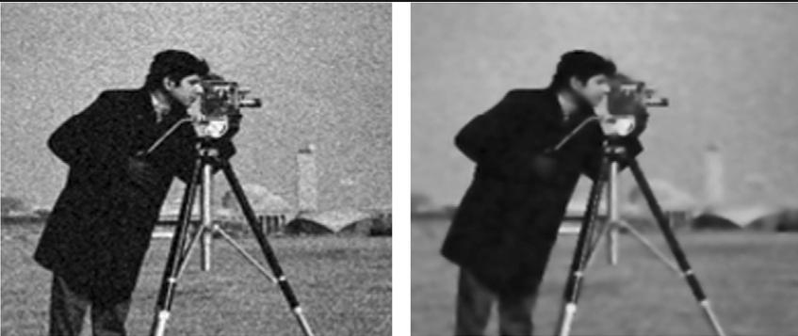
Anisotropic diffusion

Slide 7
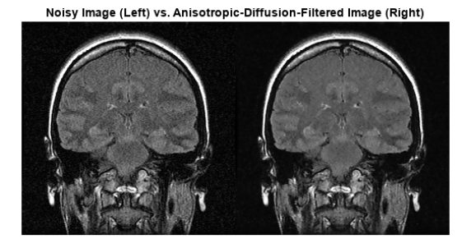
Anisotropic diffusion

